Slide 1
DB indexing
COS 518: Advanced Computer Systems
Lecture 7
Michael Freedman

Slide 2
Basic row-based storage
8 | 32 | 4 | 2 | 4 | = 50
Id BIGINT | Name CHAR(32) | Age INT | Gender SMALLINT | Birthday DATE

Slide 3
Basic row-based storage
8 | 32 | 4 | 2 | 4 | = 50
0
Id BIGINT | Name CHAR(32) | Age INT | Gender SMALLINT | Birthday DATE
50
Id BIGINT | Name CHAR(32) | Age INT | Gender SMALLINT | Birthday DATE
100
Id BIGINT | Name CHAR(32) | Age INT | Gender SMALLINT | Birthday DATE
150
Id BIGINT | Name CHAR(32) | Age INT | Gender SMALLINT | Birthday DATE

Slide 4
How to efficiently find data?
Types of queries
  Exact match: id = 139856151
  Predicate scans: All entries with age > 80
Option 1: Full scan
Option 2: Use an index!

Slide 5
Use a balanced binary tree?
Easy to do in memory
Except how do you store on disk?
  Let’s say 1M entries
  20 levels of a binary tree
  Don’t want 20 random disk seeks (say, ~200ms)

Slide 6
Strawman: Leverage locality on disk
Can collocate many pointers on disk
  Databases typically read data in “page” granularities (4-16KB per page)
But keeping a binary tree “balanced” requires many rotations (e.g., red-black tree rotations)

Slide 7
B-Tree: Disk-aware lookup tree
Each tree node sized for disk page
Internal nodes maintain pointers (to subtrees) and keys
Keys serve as bookends to subtrees
Keys also include pointer to underlying row in DB
Typically maintain sparse nodes (say, 50% empty) for cheaper insertion/deletion

Slide 8
Challenge for randomized workloads
What if we could just store 2 pages in memory?
Insert new keys in order: 10, 19, 11, 20, 13, 22, …

Slide 9
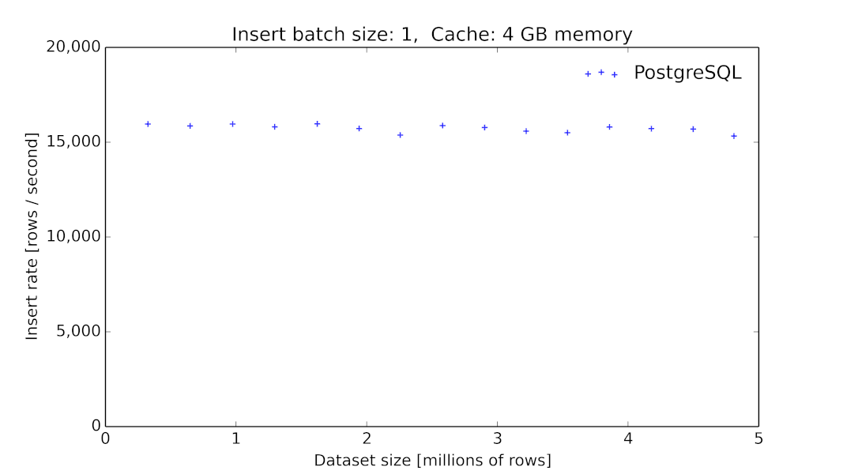
Insert throughput as F(table size)

Slide 10
Insert throughput as F(table size)

Slide 11
LSM Trees + LevelDB
Goal #1: High-throughput writes (inserts/updates/deletes)
Goal #2: Support index size >> memory size
Observation: Writes to disk should be batched for high throughput (either SSD or HDD)
Observation: Sorting/indexing in memory is fast
Main insight: Don’t try to maintain single data structure with in-place ordering

Slide 12
LSM Trees + LevelDB
Goal #1: High-throughput writes (inserts/updates/deletes)
Goal #2: Support index size >> memory size
Observation: Writes to disk should be batched for high throughput (either SSD or HDD)
Observation: Sorting/indexing in memory is fast
Main insight: Don’t try to maintain single data structure with in-place ordering

Slide 13
Collect writes and batch in memory
Collect writes in memory
  Can maintain sorted list in memory
  Can update in-place (overwrite, delete, etc.)
Disk is immutable
  Once written to disk, not modified in-place
  Queries will need to find all records and merge
  Deletes are simply “tombstone records”

Slide 14
Spill From Memory To Disk
As memory budget fills up, spill them to disk
  Write out entire sorted string table
  Write out a subtree, then remove and prune it in memory
Each dump forms a “run” ordered by write time

Slide 15
LSM Trees
SSTable: set of arbitrary, sorted key-value pairs
LSM Trees: Write to memory, then flush to disk

Slide 16
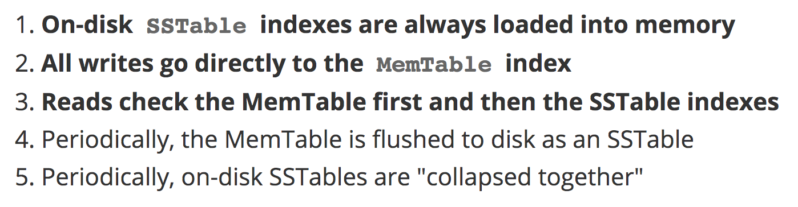
LSM Trees
LSM Trees: Write to memory, then flush to disk

Slide 17
Problem & solution
Index lookups can traverse many SSIndexes
  Esp. with range scan vs. exact-match lookup
  Other optimizations trade-off memory for additional disk lookups, e.g., bloom filter vs. SSIndex
Idea
  Merge and compact SSTables in background

Slide 18
Log-structured MERGE Tree
Merge updates disk data structures in background
  Input: K overlapping sorted SSTables from A-Z at level L
  Output: Disjoint sorted SSTables files at level L+1
Compaction also occurs as part of the merges
  Merges multiple updates into one
  Deletes tombstoned records
  Recovers storage from merged updates and deleted values
Can occur very efficiently by sequential reads from each SSTable and writing to output files (why? Hint: all sorted))

Slide 19
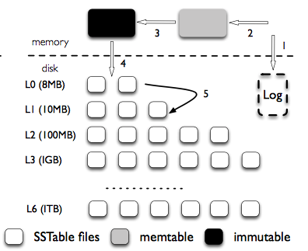
LSM Tree in Level DB

